Slide 1
Introduction
ServiceNow Track
By: ENG/Sandy Maged

Slide 2
Some Questions ...
Your Name
Let’s Get to Know Your Background
Assessing Your Knowledge Before We Start the Servicenow Course

Slide 3
Course Structure
The course will be divided into 3-hour sessions.
There will be a 10-minute break through the first session to refresh and 30-minute before the second session
Follow along in your notebook: Keep track of key points, examples, and exercises as we go. Writing down the concepts will help you retain the material better.
Feel free to stop me if you have any questions: I encourage you to ask questions at any point during the session. If something isn’t clear, just raise your hand , and I will stop to clarify
Don’t move without permission Pleaseeeeeeeeee

Slide 4
1. ServiceNow Fundamentals
ServiceNow is a versatile platform, its definition changes depending on the user role.
What is ServiceNow? ServiceNow is a reusable platform, its definition changes depending on the user role.
Customer service agent they will likely tell you that ServiceNow is a ticketing tool providing the ability to record and resolve customer requests (Ticketing Tools)
IT platform support team might define ServiceNow a Configuration management tool that keeps track of hardware and software (CMDB)
If you ask from the development team they would say that ServiceNow is a cloud-based development environment (Development Platform)

Slide 5
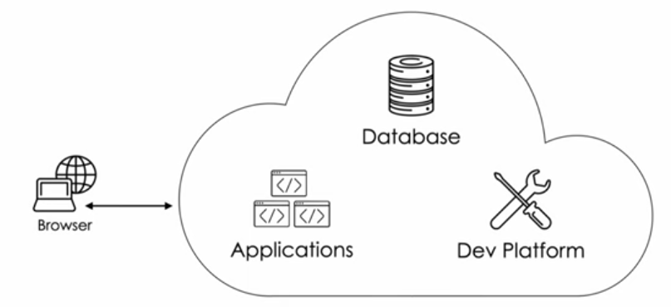
1. ServiceNow Fundamentals
What is ServiceNow?
ServiceNow is a cloud-based technology platform built to deliver common IT services.

Slide 6
1. ServiceNow Fundamentals
What is ServiceNow?
Database:
Just about everything in ServiceNow is a record in a database table
Single, enterprise-wide (there is only one database)
Over 4,0000 tables designed to meet the needs of most common IT services

Slide 7
1. ServiceNow Fundamentals
What is ServiceNow?
Applications:
Hundreds of applications installed out-of-box
Business applications to provide services for things like ALM, APM,CM,SecOps,ITSM,etc.
ServiceNow Store

Slide 8
1. ServiceNow Fundamentals
What is ServiceNow?
Dev Platform:
Modify existing (out-of-box) applications or build custom applications
No Code / Low Code / Full Code
Create custom database tables , workflows, and scripts

Slide 9
HTML
HTML is the standard markup language for creating Web pages.

Slide 10
1. Modern Web Architecture
Modern web architecture focuses on performance, scalability, and user experience. Typical flow:
Client (Browser) Renders UI using HTML, CSS, and JavaScript.
Server Handles business logic, authentication, APIs.
Data Layer Databases, caches, search engines.

Slide 11
1. Modern Web Architecture
Common patterns:
SPA / MPA (Single vs Multi-Page Apps)
SSR / CSR (Server-Side, Client-Side)
API-driven (REST, GraphQL)
Goal: fast load, smooth interaction, and maintainable code.
Notes:
الأنماط الشائعة:
تطبيقات الصفحة الواحدة / تطبيقات الصفحات المتعددة
العرض من جانب الخادم / العرض من جانب العميل / التوليد الثابت
التصميم المعتمد على واجهات برمجة التطبيقات (REST، GraphQL)
الخدمات المصغرة والعرض على الحافة
الهدف: سرعة التحميل، وسلاسة التفاعل، وسهولة صيانة الكود.

Slide 12
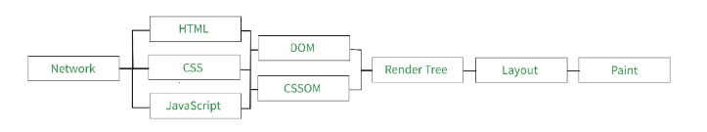
1. Modern Web Architecture
2. How Browsers Render HTML & CSS (Critical Rendering Path)
The Critical Rendering Path (CRP) is the sequence of steps a browser takes to turn code into pixels.
Notes:
2. كيف تُعرض المتصفحات HTML وCSS (مسار العرض الحرج)
مسار العرض الحرج (CRP) هو سلسلة الخطوات التي يتخذها المتصفح لتحويل الكود إلى وحدات بكسل.
https://www.geeksforgeeks.org/web-tech/critical-rendering-path-flow/

Slide 13
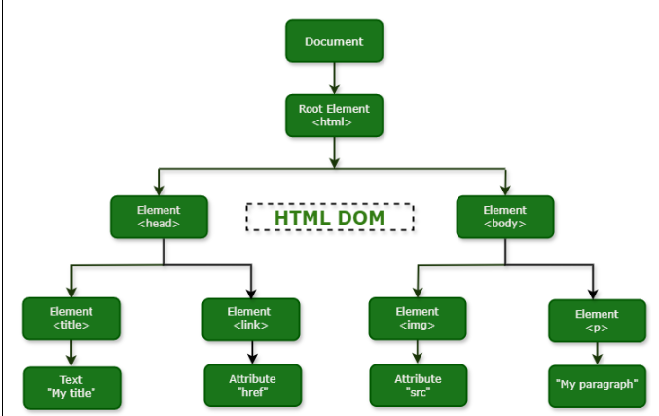
1. Modern Web Architecture
Steps:
HTML is parsed → DOM
Browser converts HTML into the Document Object Model.
DOM is a crucial part of any webpage. HTML is the first file that will be sent from the server when a webpage is loaded. Once the browser starts getting these packets(which contain bytes of code), it will start the parsing instead of waiting for all packets to be received. The browser follows an incremental DOM update approach. In parsing, first, it converts bytes to characters & then into tokens & then into nodes & then finally into the DOM tree. This cycle repeats whenever a new packet is received
Notes:
https://www.tutorialspoint.com/html/html_dom.htm

Slide 14
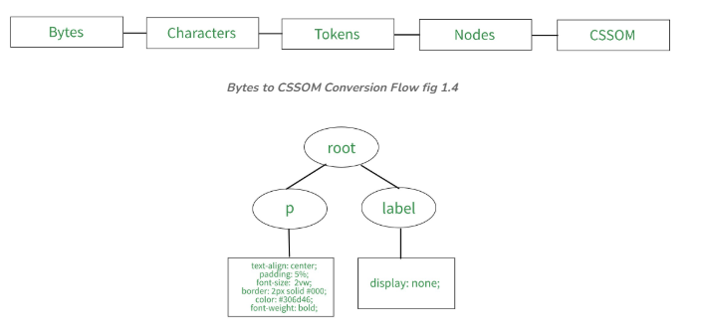
1. Modern Web Architecture
Steps:
CSS is parsed → CSSOM
All CSS rules are processed into the CSS Object Model.
Cascading Style Sheet Object Model (CSSOM): This object model focuses on the style part of a webpage. CSSOM tree construction is render-blocking, unlike DOM tree construction. Here browser will be waiting for all the packets to be received & starts parsing once all the packets of the file are received because the style properties can be replaced or overwritten in upcoming lines. The browser follows the same approach of converting Bytes to CSSOM tree
Notes:
https://www.tutorialspoint.com/html/html_dom.htm

Slide 15
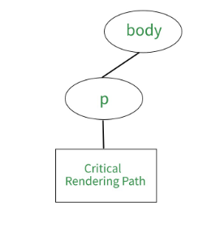
1. Modern Web Architecture
Steps:
Render Tree
DOM + CSSOM combined (only visible elements).
Render Tree: Render tree combines both the DOM & CSSOM tree into one. It takes each node from the DOM tree & maps the respective CSS object to it. Each node in the render tree has style properties assigned to it if there is any style content defined for a particular node. One thing to notice in the render tree construction is, it only catches the visible content & adds it to the tree. Since the head segment doesn't have any visibility to it, it won't be there in the render tree.
Notes:
https://www.tutorialspoint.com/html/html_dom.htm

Slide 16
1. Modern Web Architecture
Steps:
Layout (Reflow)
Calculates element sizes and positions.
Layout(Visual Formatting Model):After building the render tree, the layout comes into the picture. The layout concentrates on the placement of elements on the screen based on the size of the screen. The element having a height and width of 100% captures the whole screen. The execution of the layout depends on the nodes of the DOM tree. The more the number, the more time browser takes to build the layout. It works on the algorithm which calculates and uses a bunch of stuff like the box model, floats, and positioning. In order to actually render the page, the browser uses something called Visual Formatting Model .
Notes:
https://www.tutorialspoint.com/html/html_dom.htm

Slide 17
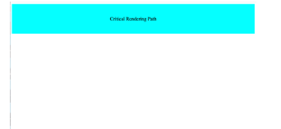
1. Modern Web Architecture
Steps:
Paint
Draws pixels to the screen.
This is the final step, after having render-tree & layout, the browser paints the pixels on the screen.
Notes:
https://www.tutorialspoint.com/html/html_dom.htm

Slide 18
1. Modern Web Architecture
Guess how can we improve performance??????????

Slide 19
1. Modern Web Architecture
Performance tips:
Minimize render-blocking CSS
Avoid heavy layout thrashing
Use async/defer for JS
Avoid unnecessary external libraries

Slide 20
1. Modern Web Architecture
3. DOM Overview
The DOM (Document Object Model) is a tree representation of the HTML document.
Key points:
Each HTML element = node
JavaScript interacts with the page via the DOM
DOM is mutable (can be changed dynamically)

Slide 21
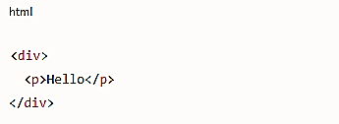
1. Modern Web Architecture
3. DOM Overview
Example:
→ becomes a tree structure in memory.
Notes:
→ يتحول إلى بنية شجرية في الذاكرة.
مفاهيم أساسية:
اجتياز DOM
انتشار الأحداث والتقاطها
أداء معالجة DOM (إعادة التدفق وإعادة الرسم)

Slide 22
1. Modern Web Architecture
Why is this important in ServiceNow?
Service Portal Widgets rely heavily on the DOM. Any UI component or widget dynamically interacts with and updates the DOM structure.
Any UI change directly impacts performance. Modifying elements, styles, or layouts can trigger reflows and repaints, which may slow down the application if not handled properly.
Optimizing the Critical Rendering Path (CRP) improves system speed and user experience. Efficient rendering ensures faster page loading, smoother interactions, and better overall portal performance.

Slide 23
1. Modern Web Architecture
4. SEO & Accessibility Importance
SEO (Search Engine Optimization)
Ensures content is discoverable by search engines.
why seo is important:
Increases traffic
Improves user experience
Builds website credibility
Helps businesses reach customers

Slide 24
1. Modern Web Architecture
How do search engines read a webpage?
Search engines don't see the design.
They only read the code.
Therefore, SEO depends on:
Page structure
Site speed
High-quality content
Using semantic HTML

Slide 25
1. Modern Web Architecture
Accessibility
Key practices:
Semantic HTML
ARIA roles (only when needed)
Keyboard navigation
Screen-reader support
Color contrast & readable fonts
Notes:
إمكانية الوصول (a11y)
تضمن سهولة استخدام الويب للجميع، بمن فيهم ذوو الإعاقة.
الممارسات الرئيسية:
HTML الدلالي
أدوار ARIA (عند الحاجة فقط)
التنقل باستخدام لوحة المفاتيح
دعم قارئات الشاشة
تباين الألوان وخطوط مقروءة
فوائد إمكانية الوصول:
الامتثال القانوني
تجربة مستخدم أفضل لجميع المستخدمين
تحسين محركات البحث (تقرأ محركات البحث المحتوى كما لو كان قارئ شاشة)

Slide 26
2. Advanced HTML5
1. Semantic HTML (In Depth)
Semantic HTML uses elements that clearly describe their meaning and purpose, not just layout.
Common Semantic Elements
<header> – Intro content or navigation
<nav> – Primary navigation links
<main> – Main content (one per page)
<section> – Thematic grouping of content
<article> – Independent, reusable content
<aside> – Related but secondary content
<footer> – Footer info for a section/page
<figure> / <figcaption> – Media with captions

Slide 27
2. Advanced HTML5
Why it matters:
Improves readability & maintainability
Enables screen readers to understand structure
Helps search engines index content properly

Slide 28
2. Advanced HTML5
2. Accessibility – ARIA Roles & Attributes
ARIA (Accessible Rich Internet Applications) helps make dynamic or custom UI components accessible.
Common ARIA Roles
role="button"
role="navigation"
role="dialog"
role="alert"
role="tabpanel"
Important ARIA Attributes
aria-label – Accessible name
aria-labelledby – References visible text
aria-hidden – Hides from screen readers
aria-expanded – Toggle state
aria-live – Announces dynamic updates

Slide 29
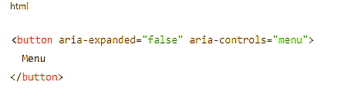
2. Advanced HTML5
Example
ARIA Best Practices
Do not override native semantics
Always keep ARIA state in sync
Never use ARIA as a replacement for semantic elements Keyboard support is mandatory

Slide 30
2. Advanced HTML5
3. SEO-Friendly HTML Structure
Search engines rely heavily on document structure.
Best Practices
One <h1> per page (main topic)
Logical heading order (h1 → h2 → h3)
Use semantic containers (<article>, <section>)
Meaningful anchor text (avoid “click here”)
Image alt attributes for content images

Slide 31
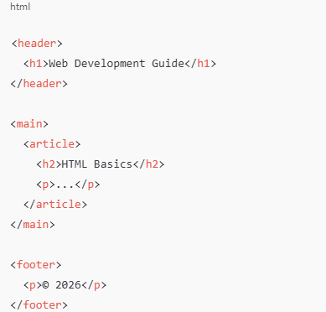
2. Advanced HTML5
Example
Result:
Better crawlability
Higher rankings
Improved accessibility

Slide 32
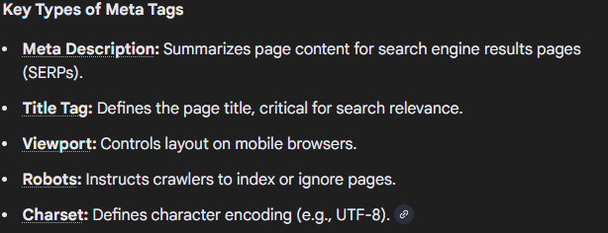
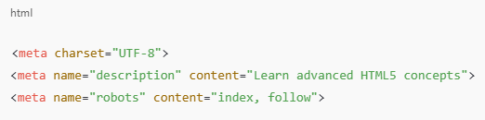
2. Advanced HTML5
4. Meta Tags (SEO, Viewport, Social Sharing)
Essential SEO Meta Tags
Meta tags are HTML snippets placed in a page's <head> section that provide structured metadata—such as titles, descriptions, and viewport settings—to search engines and browsers. They do not appear on the page itself but control indexing, responsiveness, and how content is displayed in search results.
description → affects search snippet
robots → indexing behavior

Slide 33
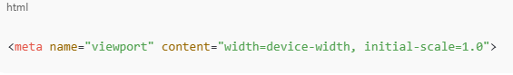
2. Advanced HTML5
Viewport (Mobile Optimization)
Critical for responsive design and Core Web Vitals.
The viewport meta tag is a small but crucial piece of HTML code that provides instructions to the browser on how to control the page's dimensions and scaling, which is essential for responsive web design and ensuring a good user experience on mobile devices.
Notes:
يُعدّ عنصر "viewport meta tag" بالغ الأهمية لتصميم المواقع المتجاوبة ومؤشرات الأداء الرئيسية للويب.
يُمثّل عنصر "viewport meta tag" جزءًا صغيرًا ولكنه أساسي من كود HTML، حيث يُزوّد ​​المتصفح بتعليمات حول كيفية التحكم في أبعاد الصفحة وتوسيعها، وهو أمر ضروري لتصميم مواقع متجاوبة وضمان تجربة مستخدم ممتازة على الأجهزة المحمولة.

Slide 34
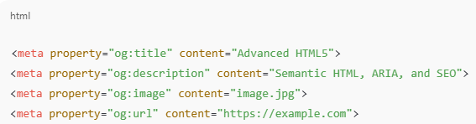
2. Advanced HTML5
Social Sharing Meta Tags
Open Graph (Facebook, LinkedIn)

Slide 35
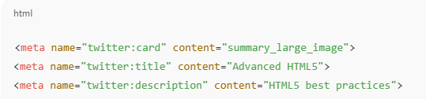
2. Advanced HTML5
Twitter Cards

Slide 36
3. Forms & Validations
1. HTML5 Form Elements
HTML5 introduced powerful built-in form controls that reduce JavaScript dependency.
Core Form Elements
<form> – Form container
<label> – Accessible field labeling
<input> – Multiple input types
<textarea> – Multi-line text
<select> / <option> / <optgroup>
<button> – Submit / reset / custom actions
<fieldset> / <legend> – Group related fields

Slide 37
3. Forms & Validations
Best Practice
<label for="email">Email</label>
<input id="email" name="email" type="email">
✔ Improves usability ✔ Required for accessibility ✔ Helps screen readers

Slide 38
3. Forms & Validations
Input Types (Advanced Overview)
HTML5 input types provide built-in validation, keyboards, and UX improvements.
Common Input Types
Type | Purpose
email | Valid email format
password | Masked input
number | Numeric input
tel | Phone keypad
url | URL validation
date | Date picker
range | Slider input
file | File upload
color | Color picker
search | Search field

Slide 39
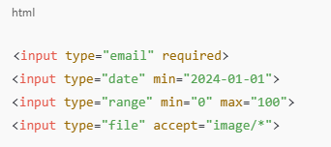
3. Forms & Validations
Example
Benefits
Automatic validation
Mobile-optimized keyboards
Consistent UX across browsers

Slide 40
3. Forms & Validations
Native Validation
HTML5 provides constraint validation API — no JavaScript required for basic rules.
Common Validation Attributes
required
min / max
minlength / maxlength
pattern
step
readonly / disabled

Slide 41
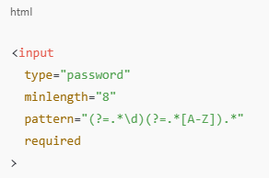
3. Forms & Validations
Example

Slide 42
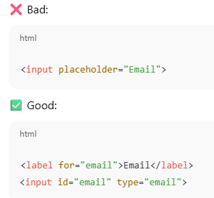
3. Forms & Validations
4. Accessibility in Forms (Critical)
Forms are one of the biggest accessibility failure points.
1. Proper Labeling
Every input must have a <label>
Use for + id
Avoid placeholder-only labels

Slide 43
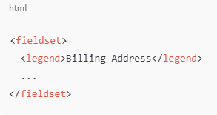
3. Forms & Validations
2. Grouping Related Fields
Helps screen readers understand context.

Slide 44
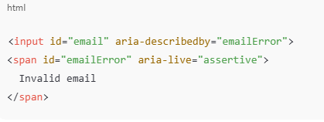
3. Forms & Validations
3. Error Messages (Accessible)
Errors must be programmatically associated
Use aria-describedby
Announce errors with aria-live

Slide 45
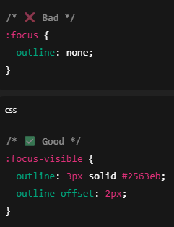
3. Forms & Validations
4. Keyboard Navigation
All fields reachable via Tab
No keyboard traps
Visible focus styles
5. Required Fields
Use required attribute
Indicate visually and programmatically
Avoid only using color to indicate errors

Slide 46
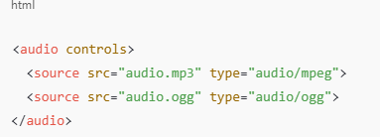
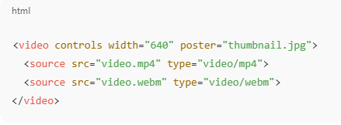
4. Multimedia & Performance
1. Audio & Video Tags
HTML5 provides native media support without plugins.
<audio> Tag
<video> Tag

Slide 47
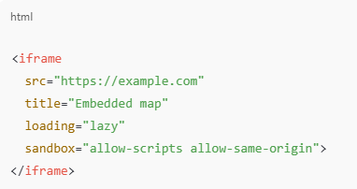
4. Multimedia & Performance
2. iframe
<iframe> embeds external content (maps, videos, widgets) — use carefully.
Best Practices
Always set title (accessibility)
Use loading="lazy"
Restrict permissions with sandbox
Limit size and usage (iframes are heavy)

Slide 48
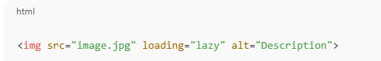
4. Multimedia & Performance
3. Lazy Loading Images
Benefits
Faster initial page load
Reduced bandwidth usage
Best Practices
Always include width & height to prevent layout shifts
Combine with responsive images

Slide 49
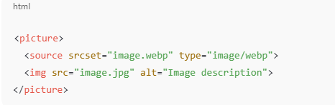
4. Multimedia & Performance
4. Image Formats (WebP, SVG)
Choosing the right format has a huge impact on performance
WebP
Modern raster image format
~25–35% smaller than JPEG/PNG
Supports transparency & animation
✔ Best for photos ✔ Great compression ✔ Wide browser support

Slide 50
4. Multimedia & Performance
4. Image Formats (WebP, SVG)
SVG
Vector-based
Infinitely scalable
Very small file size for icons & logos
<svg width="24" height="24" aria-hidden="true">
...
</svg>
✔ Perfect for icons ✔ Stylable via CSS ✔ Accessible with proper labels

Slide 51
4. Multimedia & Performance
4. Image Formats (WebP, SVG)
Quick Comparison
Format | Best For
JPEG | Photos
PNG | Transparency
WebP | Modern images
SVG | Icons, logos
AVIF | Next-gen (even smaller than WebP)

Slide 52
2. Advanced CSS Core
CSS Architecture & Scalable Styles
CSS architecture is about organizing styles so they are reusable, maintainable, and scalable
Prevents problems like:
Style conflicts
Large, unreadable stylesheets
Difficulty updating UI components
Common architecture principles:
Separation of concerns (layout, components, utilities)
Component-based styling
Consistent naming conventions
Popular architecture approaches:
BEM (Block, Element, Modifier)
Utility-first (e.g., Tailwind concepts)
Goal: Write CSS that grows well as the project grows
Notes:
هندسة CSS والأنماط القابلة للتطوير
تُعنى هندسة CSS بتنظيم الأنماط بحيث تكون قابلة لإعادة الاستخدام والصيانة والتطوير.
تمنع مشاكل مثل:
تعارض الأنماط
ملفات أنماط كبيرة وغير قابلة للقراءة
صعوبة تحديث مكونات واجهة المستخدم
مبادئ الهندسة الشائعة:
فصل الاهتمامات (التخطيط، المكونات، الأدوات المساعدة)
التصميم القائم على المكونات
اتفاقيات تسمية متسقة
مناهج الهندسة الشائعة:
BEM (الكتلة، العنصر، المُعدِّل)
SMACSS
الأولوية للأدوات المساعدة (مثل مفاهيم Tailwind)
الهدف: كتابة CSS يتطور بشكل جيد مع نمو المشروع

Slide 53
2. Advanced CSS Core
CSS Specificity & Cascade (Deep Dive)
CSS decides which style wins using:
Importance (!important)
Specificity
Source order
Specificity hierarchy:
Inline styles → Highest
IDs (#header)
Classes, attributes, pseudo-classes (.btn, :hover)
Elements and pseudo-elements (div, ::before)
Problems caused by poor specificity:
Overuse of !important
Hard-to-override styles
Best practices:
Keep selectors simple
Avoid IDs for styling
Rely on class-based selectors
Notes:
التخصيص والتأثير المتتالي في CSS (نظرة معمقة)
يُحدد CSS النمط المُعتمد باستخدام:
الأهمية (!important)
التخصيص
ترتيب المصدر
تسلسل التخصيص:
الأنماط المضمنة ← الأعلى
المعرفات (#header)
الفئات، والخصائص، والفئات الزائفة (.btn، :hover)
العناصر والعناصر الزائفة (div، ::before)
المشاكل الناتجة عن ضعف التخصيص:
الإفراط في استخدام !important
صعوبة تجاوز الأنماط
أفضل الممارسات:
تبسيط المُحدِّدات
تجنب استخدام المعرفات للتنسيق
الاعتماد على المُحدِّدات القائمة على الفئات

Slide 54
2. Advanced CSS Core
Modern CSS Functions
calc()
Performs mathematical calculations in CSS
Example use cases:
Dynamic widths and heights
Combining different units
Example:
width: calc(100% - 40px);

Slide 55
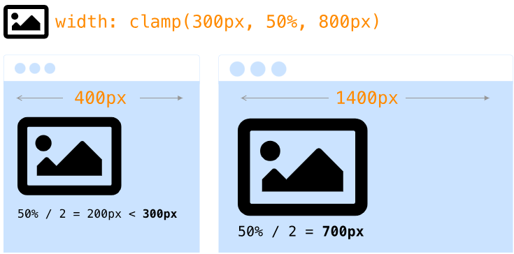
2. Advanced CSS Core
Modern CSS Functions
clamp()
Sets a value between a minimum, preferred, and maximum
The CSS clamp() function is a powerful tool for responsive design that allows you to set a value within a range between a defined minimum and maximum bound. It simplifies the process of creating fluid layouts and typography by using a single line of code instead of multiple media queries.
Ideal for responsive typography and spacing
Example:
font-size: clamp(16px, 2vw, 24px);
Benefits:
Eliminates many media queries
Creates fluid, responsive layouts
Notes:
https://css-tricks.com/linearly-scale-font-size-with-css-clamp-based-on-the-viewport/

Slide 56
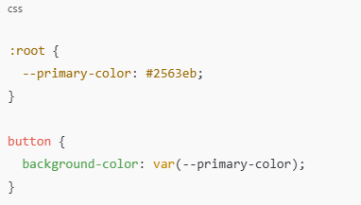
2. Advanced CSS Core
CSS Variables (Custom Properties)
Variables that store reusable values
Defined using --variable-name
Example:
Advantages:
Centralized theme control
Easy dark/light mode switching
Runtime updates with JavaScript
Scope-aware (inherit like normal CSS properties)

Slide 57
2. Advanced CSS Core
3. CSS vs SCSS (Conceptual Introduction)
What is SCSS
SCSS (Sassy CSS) is a CSS preprocessor
Extends CSS with additional features
Browsers cannot read SCSS directly
Must be compiled into standard CSS

Slide 58
2. Advanced CSS Core
Why SCSS Was Created
CSS lacks programming features
SCSS solves problems like:
Repeated code
Hard-to-maintain styles
No logic or structure
Adds:
Variables
Nesting
Functions
Mixins
Partials & imports

Slide 59
2. Advanced CSS Core
When to Use CSS vs SCSS
Use CSS when:
Small or simple projects
No build tools
Modern CSS features are enough
Use SCSS when:
Large-scale applications
Design systems
Repeated patterns & themes
Team collaboration
Complex UI logic

Slide 60
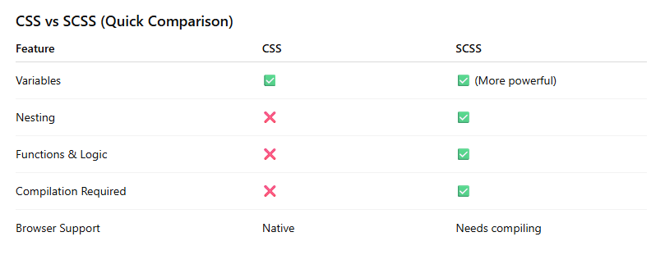
2. Advanced CSS Core

Slide 61
Lab Time
Building a 20-page supermarket project using only HTML and CSS is a fantastic way to master layout consistency and navigation. Since you aren't using JavaScript or a backend, the "logic" (like adding to a cart) won't function, but you can create a highly professional prototype.
Here is a blueprint to organize your 20 pages effectively.
🏗️ The Project Structure
To reach 20 pages without it feeling repetitive, we’ll break the supermarket into specific departments and customer service areas.
1. Core Pages (4 Pages)
Index.html: The landing page with a big hero banner, featured deals, and department links.
About.html: History of the supermarket, mission statement, and team.
Contact.html: Contact form (styled), Google Maps embed placeholder, and store hours.
Locations.html: A list of different branch addresses and phone numbers.

Slide 62
Lab Time
2. Shopping Departments (10 Pages)
Each page will showcase a unique grid of products.
Produce.html (Fruits & Vegetables)
Bakery.html (Bread & Pastries)
Dairy-Eggs.html
Meat-Seafood.html
Frozen-Foods.html
Beverages.html (Juices, Coffee, Soda)
Snacks.html (Chips, Cookies)
Pantry.html (Pasta, Rice, Canned Goods)
Household.html (Cleaning supplies)
Personal-Care.html (Shampoo, Soap)
3. Customer Experience (6 Pages)
Weekly-Ads.html: A "digital flyer" layout.
Recipes.html: A blog-style page showing meals you can make with store items.
Careers.html: Job listings and a "Join the Team" section.
FAQ.html: Frequently asked questions.
Privacy-Policy.html: Standard legal text layout.
Cart-Preview.html: A static mockup of what a full shopping cart would look like.

Slide 63
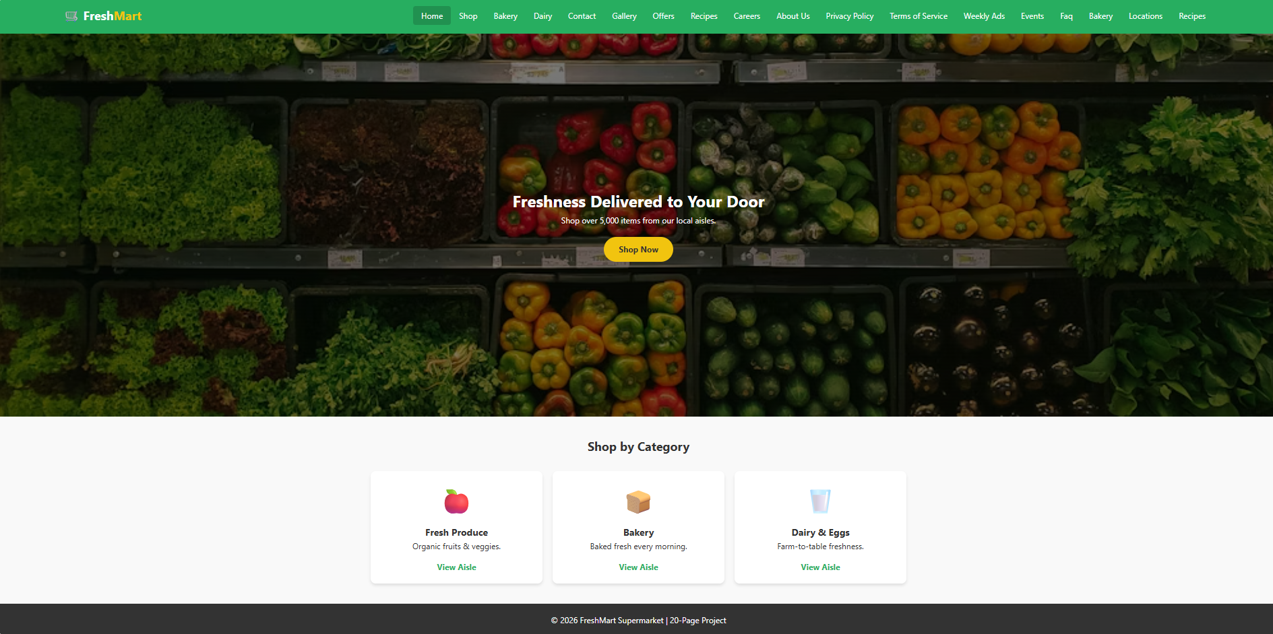
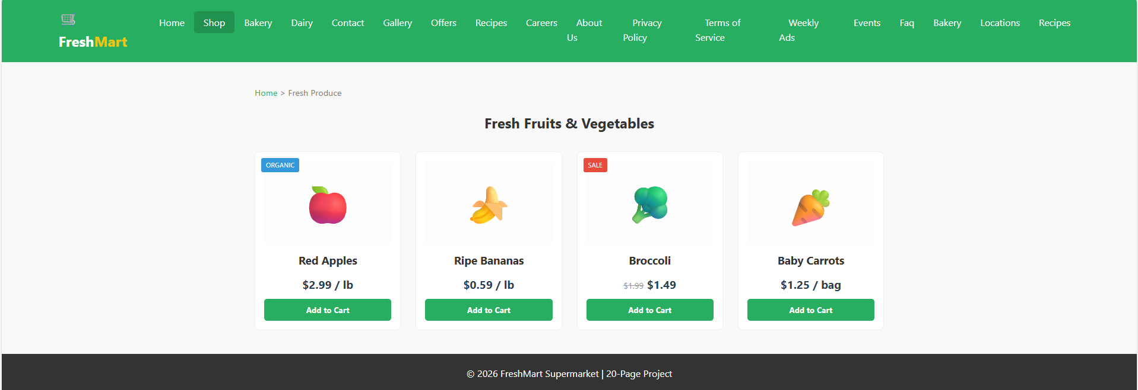
Lab Time

Slide 64
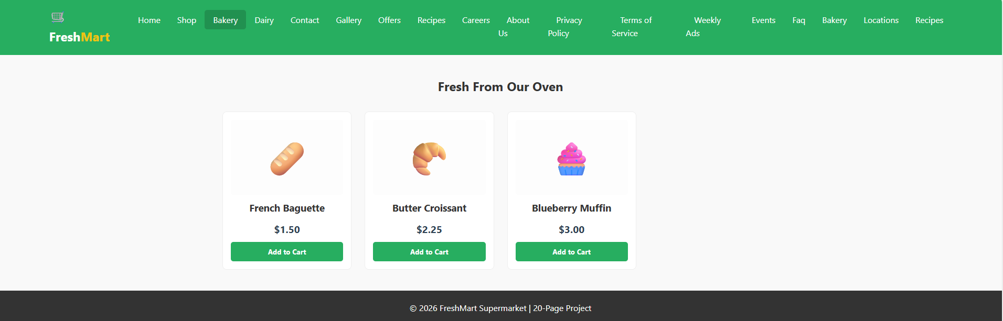
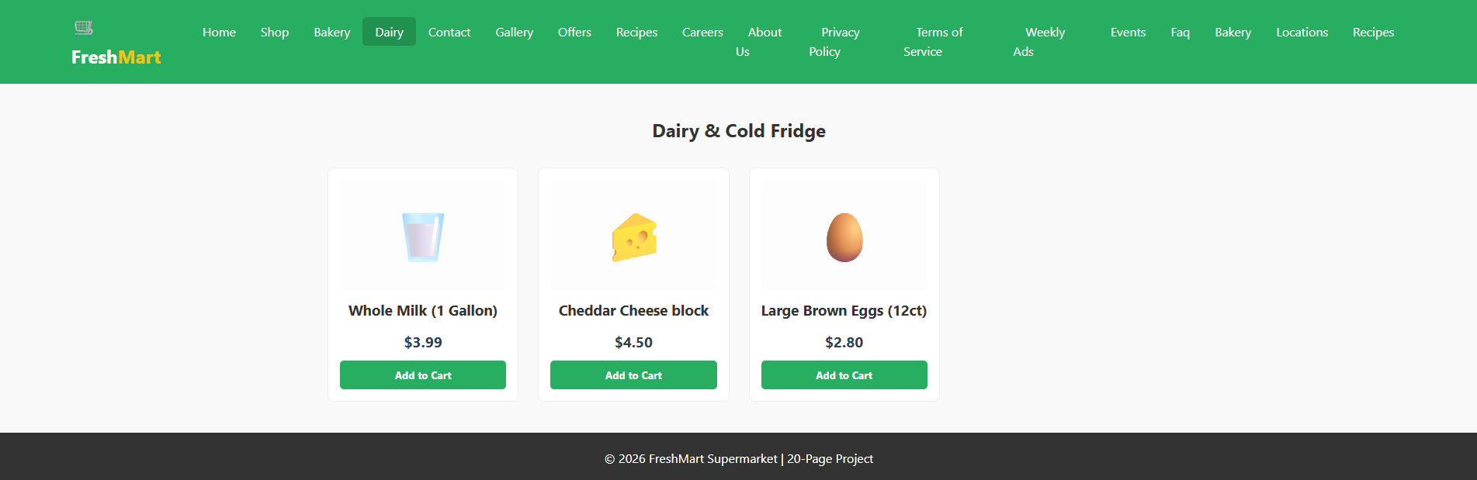
Lab Time

Slide 65
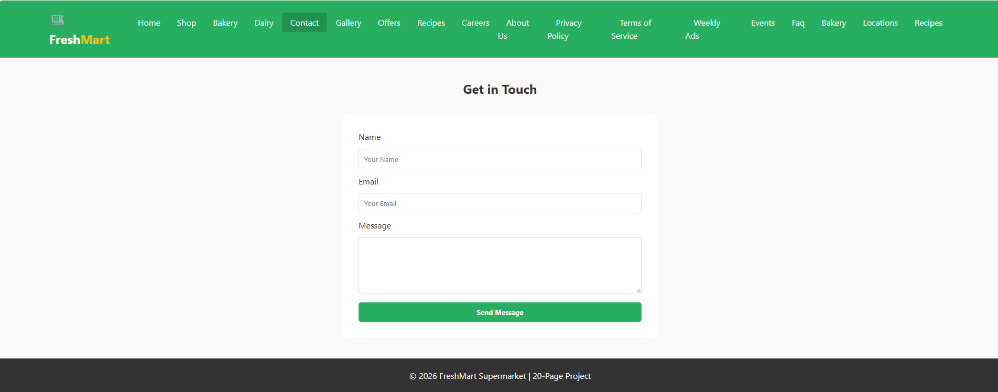
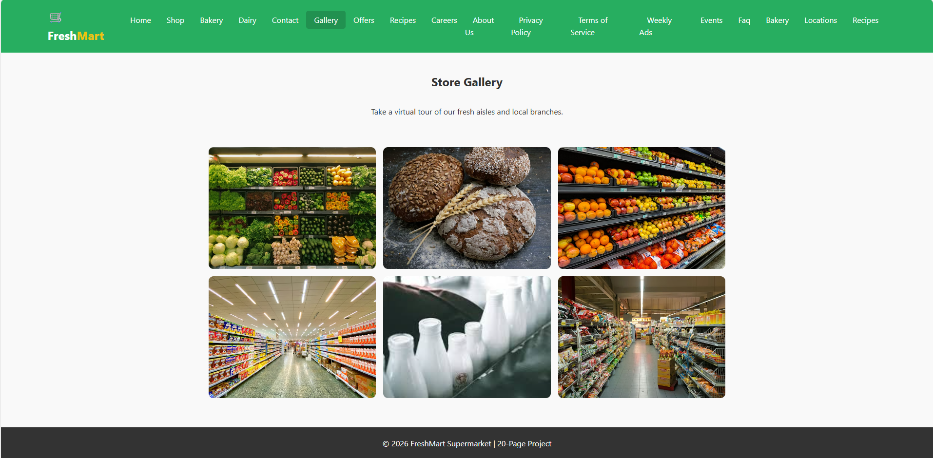
Lab Time

Slide 66
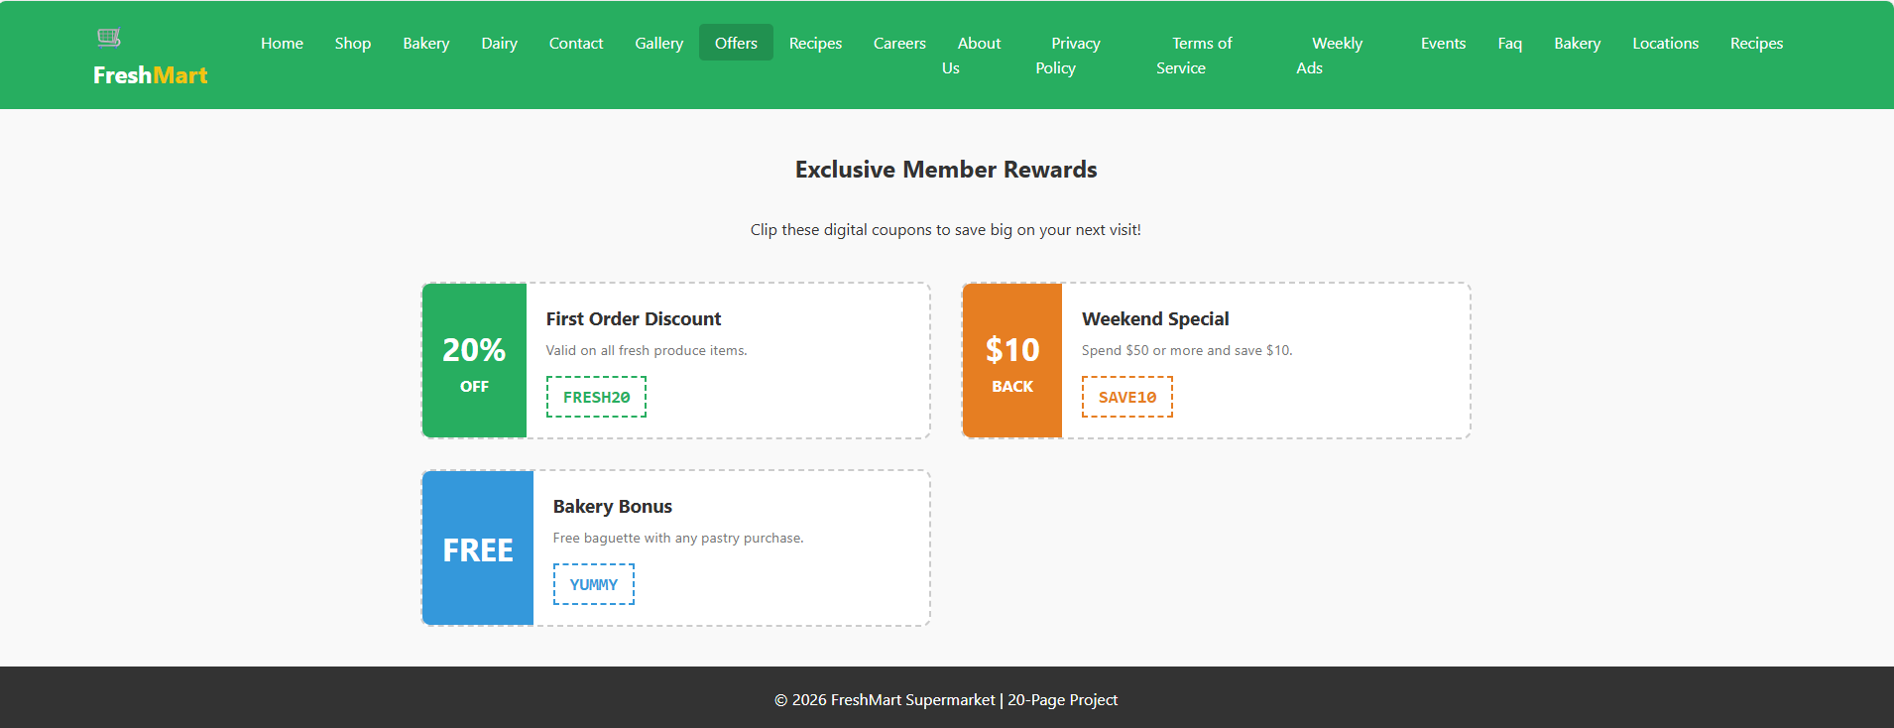
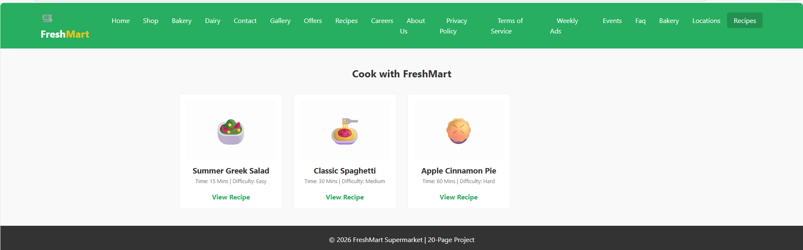
Lab Time

Slide 67
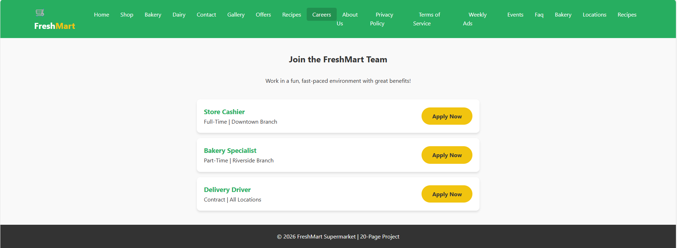
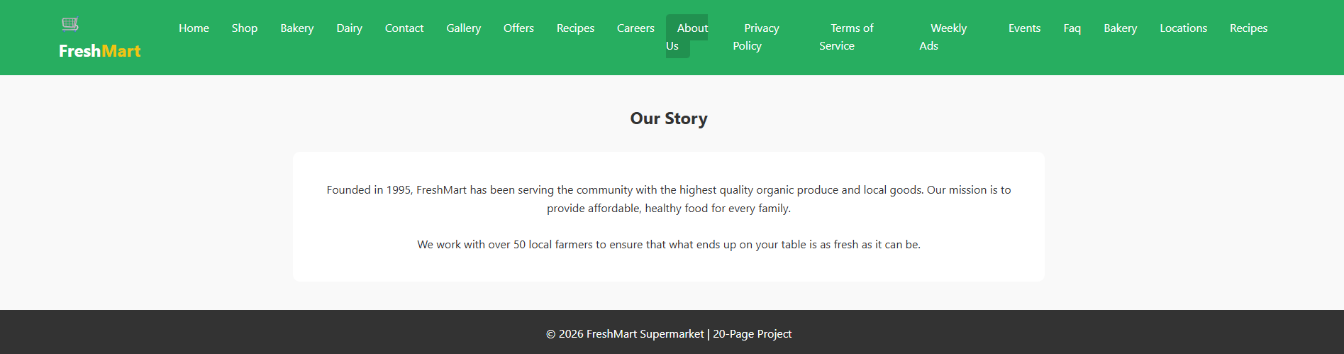
Lab Time

Slide 68
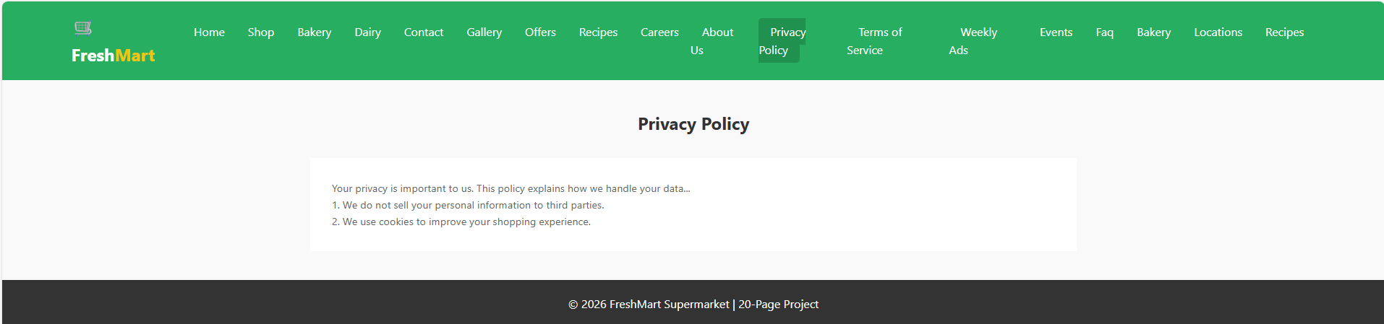
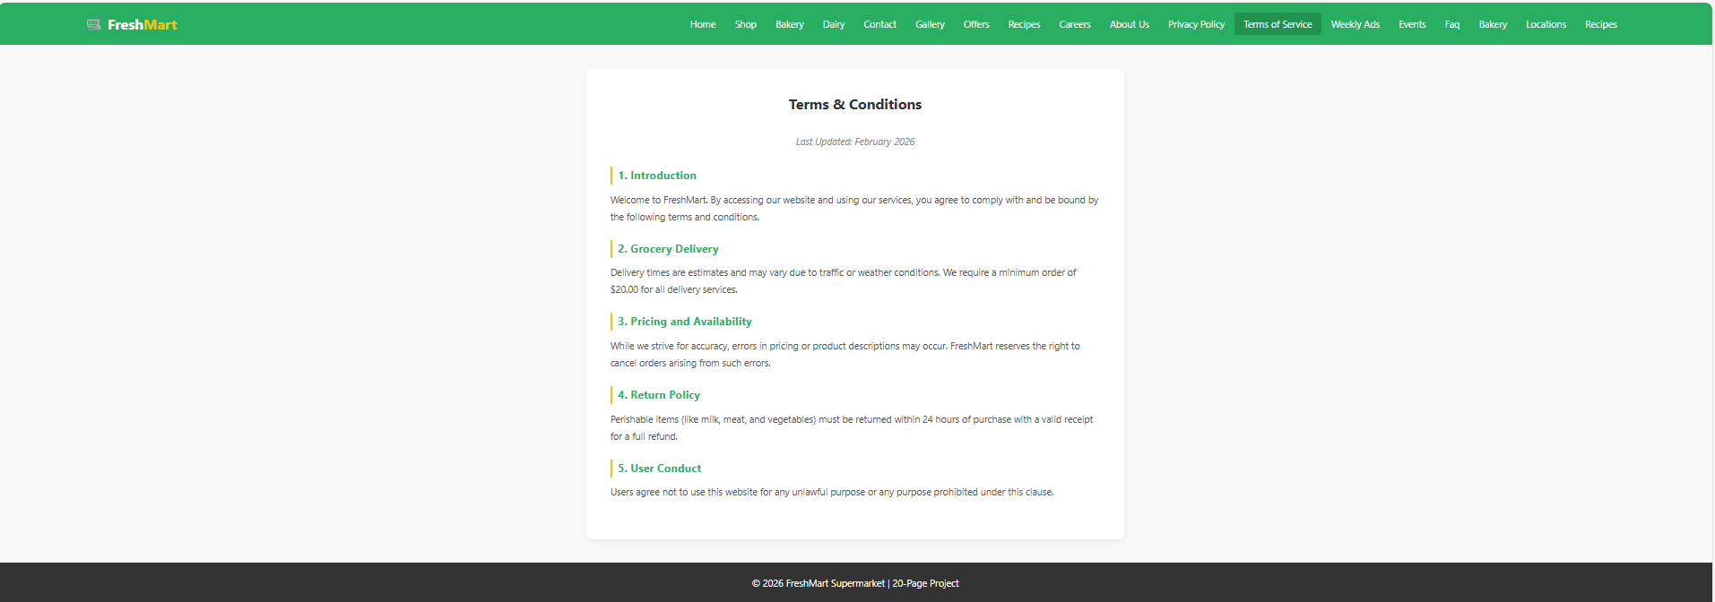
Lab Time

Slide 69
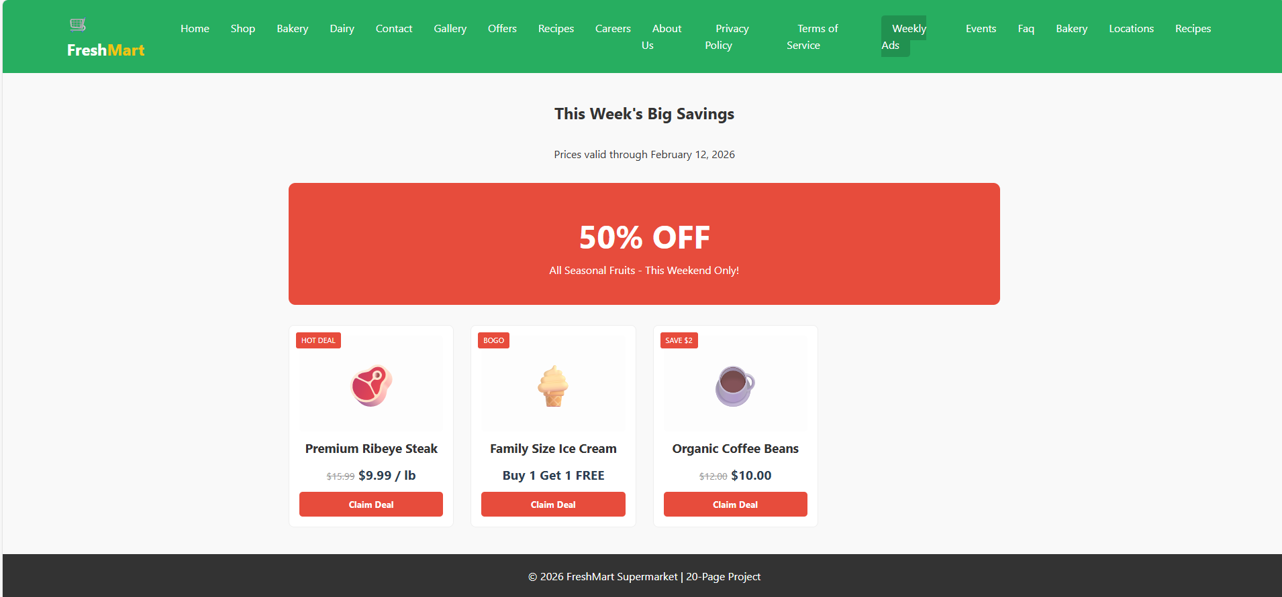
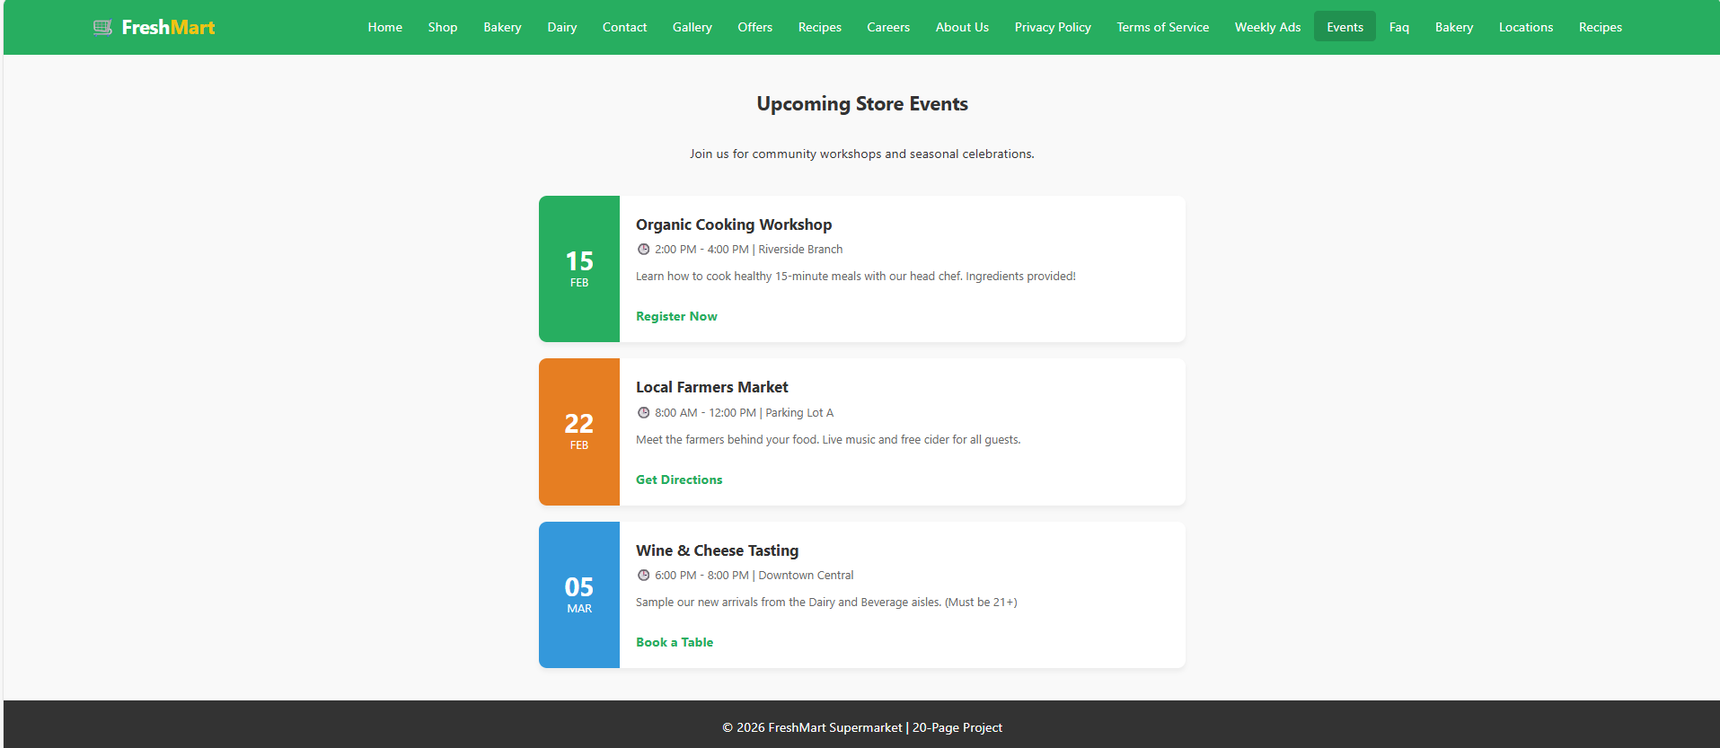
Lab Time

Slide 70
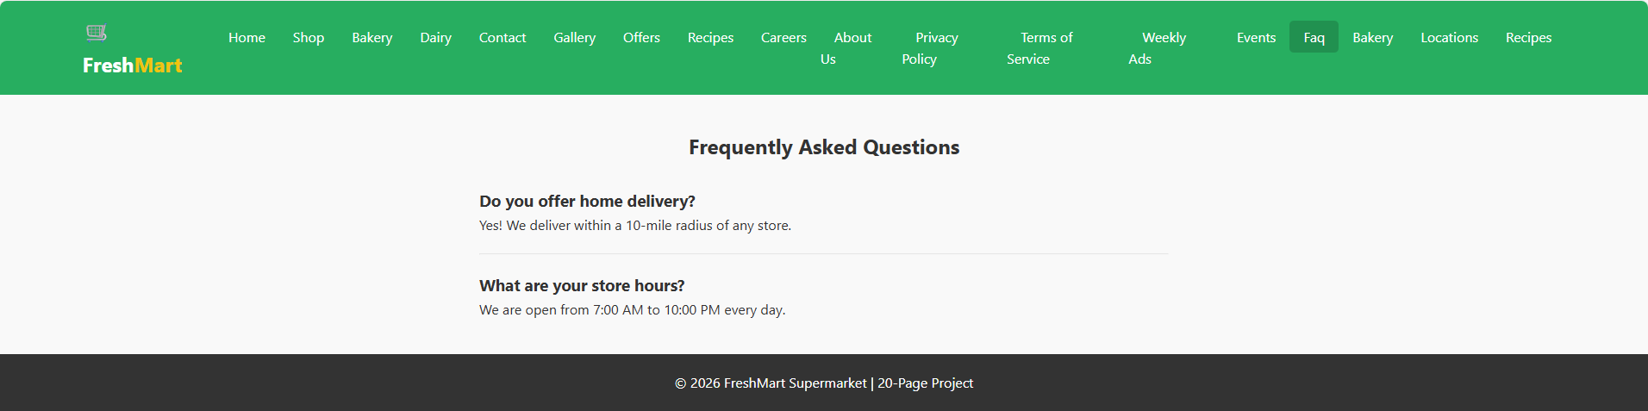
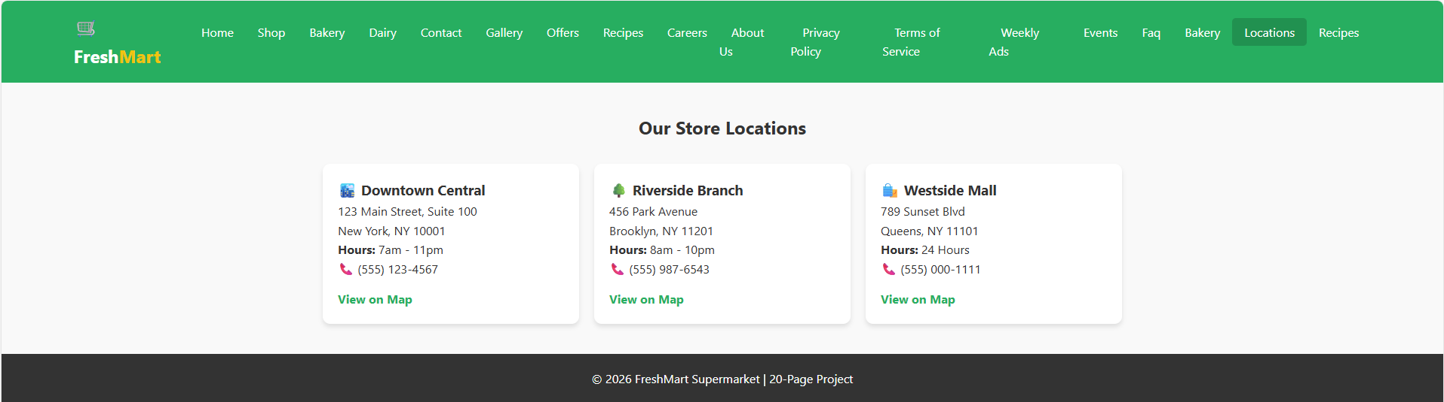
Lab Time

Slide 71
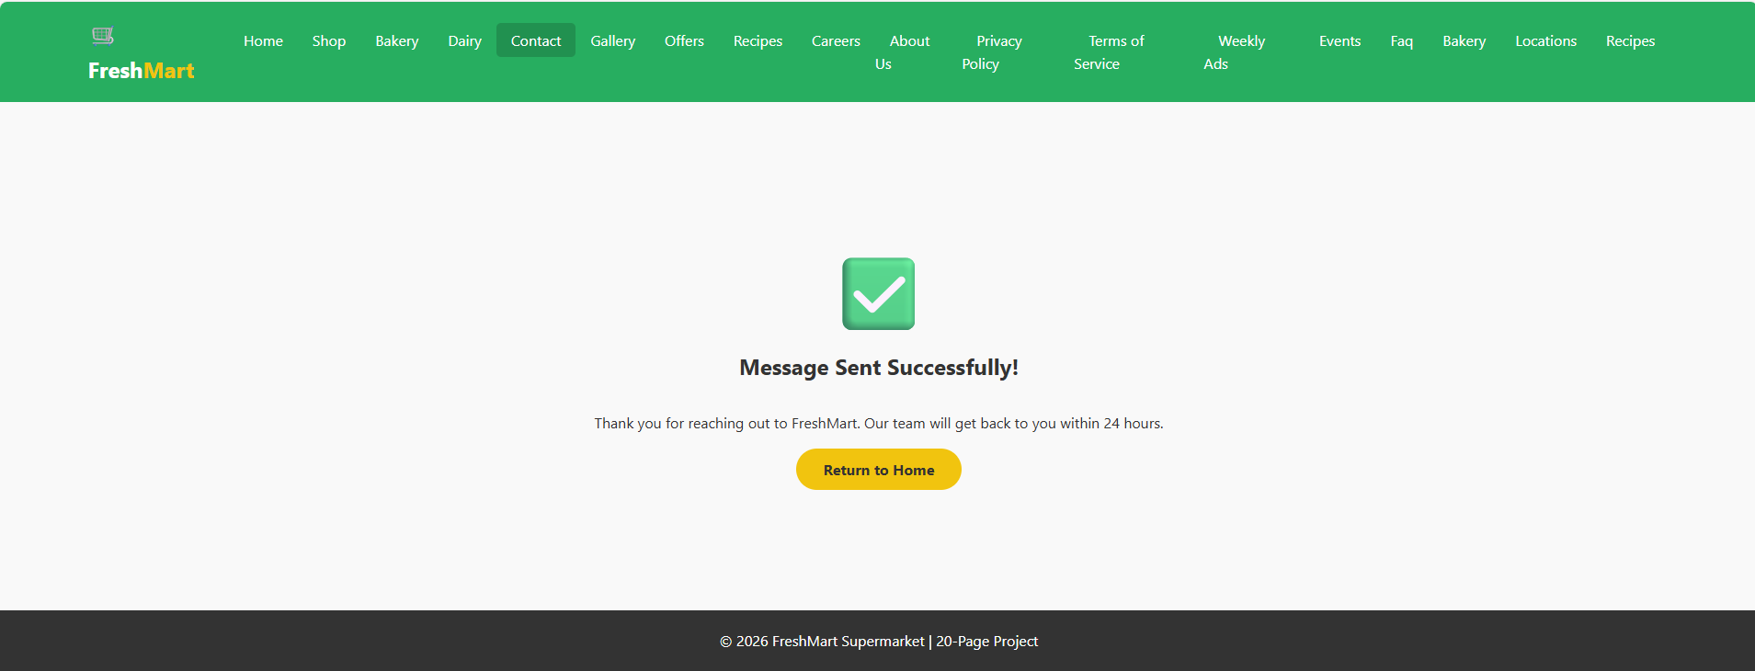
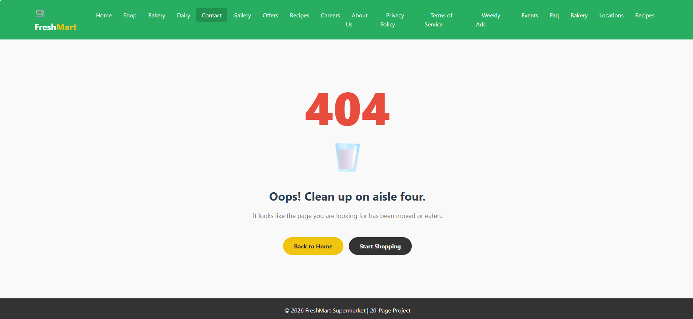
Lab Time

